Slide 1
SandShark Battery
April 21, 2014
Notes:
These slides should not be business sentive.

Slide 2
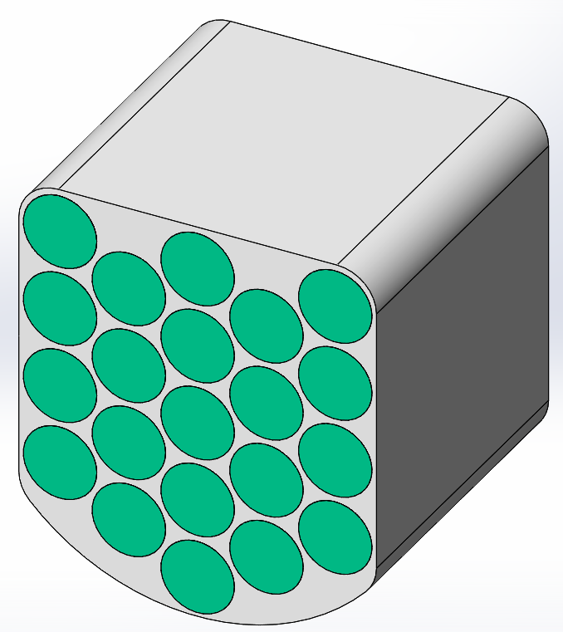
Battery

Slide 3
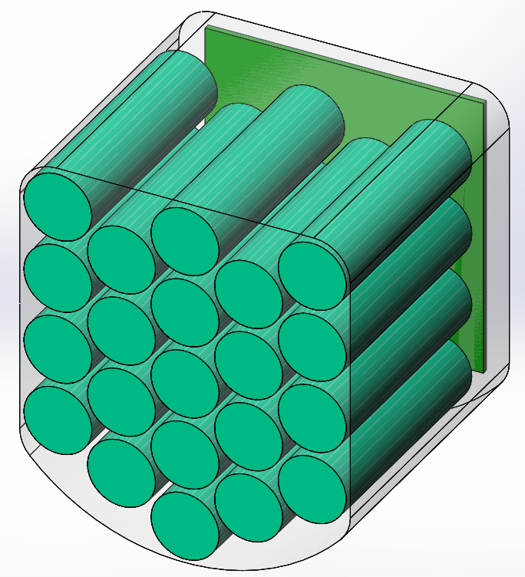
Battery

Slide 4
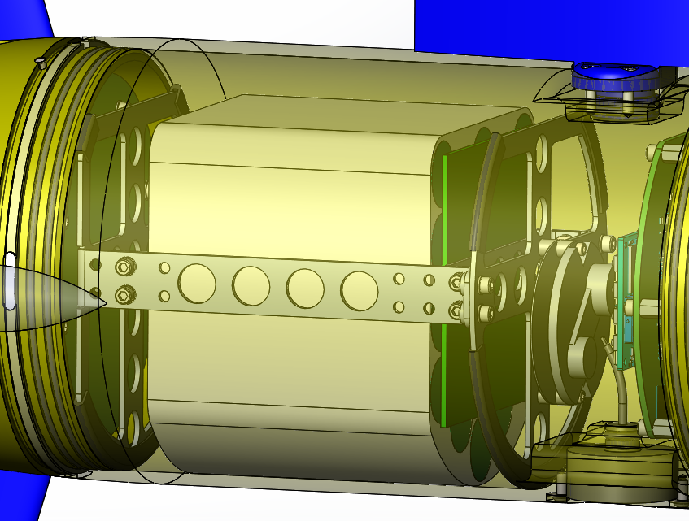
Battery

Slide 5
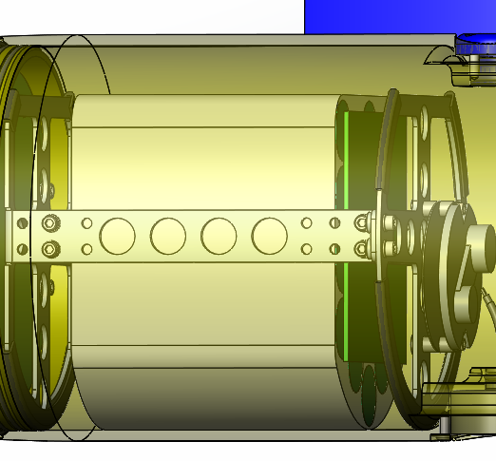
Battery

Slide 6
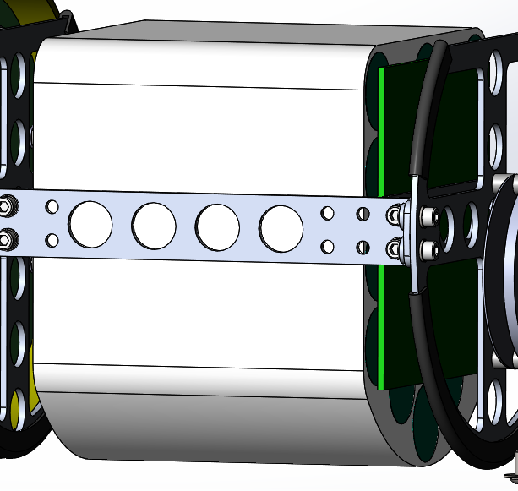
Battery

